Slide 1

Industrial Computing Design Project 3 - DES371S
EMMY: NLP Based Student Support Chatbot
E. Mkalipi, 240681185
Weekly Progress Update: 23 July 2026

Slide 2
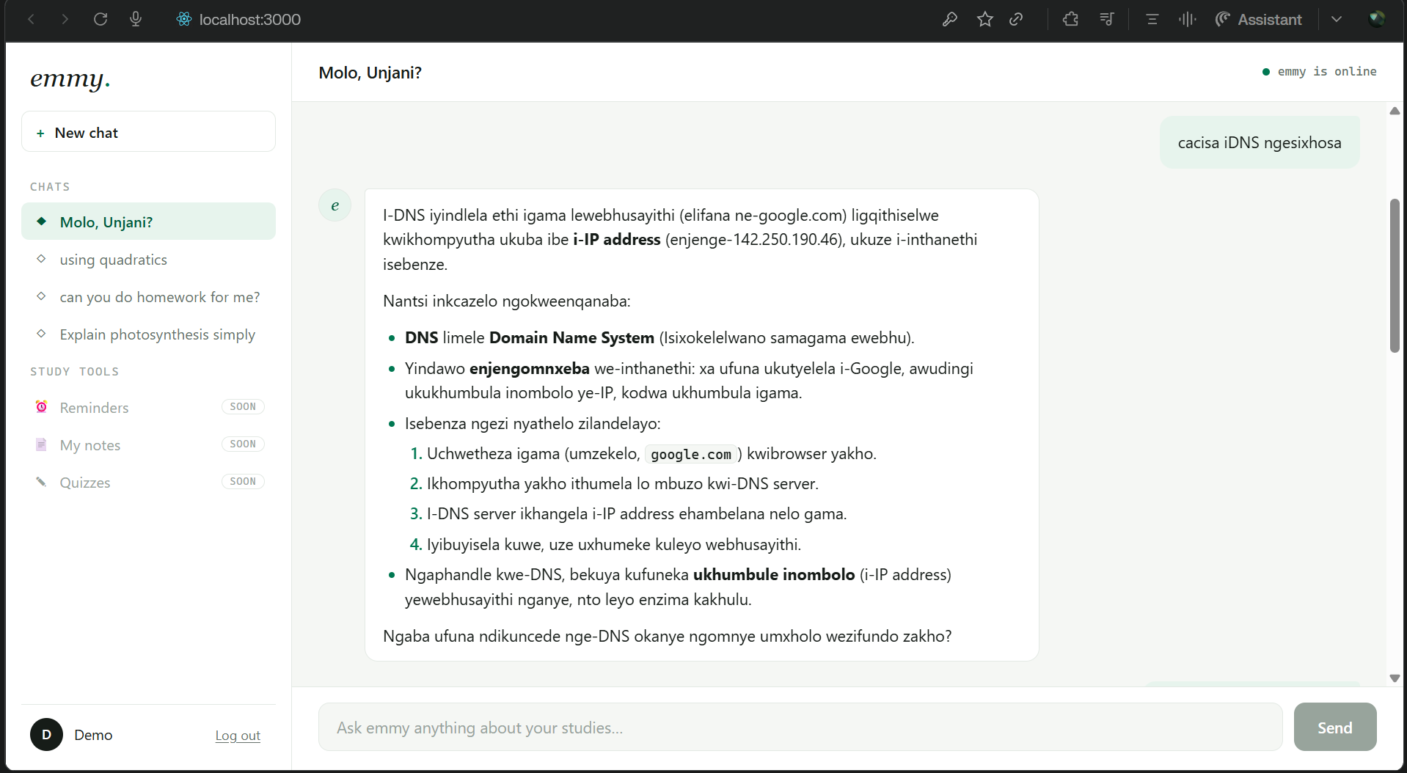
Project Overview
Goal: a web app where students log in and chat with emmy, an AI study buddy, for academic help, explanations and motivation.
Stack: React frontend, Flask backend, MySQL database, and the DeepSeek AI model.
Approach: an NLP chatbot that teaches rather than just answers, formats replies in Markdown with real maths, and keeps each conversation in context.
Multilingual: emmy now replies in the language the student writes in, shown here answering a DNS question in isiXhosa.
emmy answering in isiXhosa in the running app

Slide 3
What has been done so far
Register and login: working end to end, from the React UI through the Flask API to the MySQL Users table.
AI chat: students chat with emmy; replies teach in a set voice and render in Markdown with proper LaTeX maths.
Context kept: the chat now sends prior turns, so follow-ups like "solve one" stay on topic instead of losing the thread.
History persists: named chats are saved to MySQL and restored in the sidebar after a refresh or re-login.
Multilingual replies (21 July): emmy answers in the student's own language, verified live in isiXhosa.

Slide 4
Current stage
Core loop complete: login plus multi-turn, persistent, multilingual chat runs end to end against the API.
Verified in the running app: driven in a real browser, not just unit tests; the full suite passes 18 of 18.
Portable and version-controlled: the whole database rebuilds from files with one command, and git keeps the API key out of the repo.
Foundation stage: the working study-buddy chat is the base; the larger study tools are the next build phase.

Slide 5
Challenges and how they were handled
Broken virtual environment: a venv copied from another machine would not run, so I rebuilt it locally and pinned the dependencies in requirements.txt.
Chat lost its memory: only the newest message reached the AI, so I now send the prior turns and sanitise them on the backend.
History vanished on refresh: chat lived only in React state, so I added database tables that save each exchange, best-effort so a hiccup never drops a reply.
Maths showed as plain text: formulas rendered as ASCII in grey boxes, so I switched to LaTeX with KaTeX and fixed a bug that uppercased maths.
Security debt noted: passwords are still stored in plain text, logged as a known issue for the next slice.

Slide 6
Next steps
Hash passwords: replace plain-text storage, the top security fix before anything else.
Build the study tools: wire the schema-ready features into the app: reminders, note uploads, quizzes, profiles and feedback.
Grow toward full scope: move to the fuller proposal vision: voice input, emotion recognition, and weather integration.
Spot-check languages: verify isiZulu, Sesotho and Setswana replies, since AI quality varies by language.
Close small gaps: add a delete-session option and a smarter, token-aware history window.

Slide 7
Thank you and Questions

